Slide 1
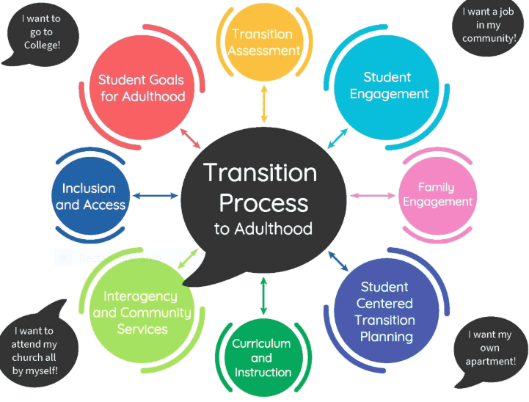
Connecting the Dots Transition Planning
Rosa Chavez
San Gabriel Pomona Regional Center
June 17th, 2020

Slide 2
Focus of Transition Services Unit
(Ages 13-23)
Facilitate IPP meeting
Connect family to public (generic) and community resources
Collaborate with SCs from other Service Units, as appropriate
Provide information about the Employment First Policy
Provide information about the Workforce Innovation and Opportunity Act (WIOA)

Slide 3
Regional Center Eligibility
Autism
Cerebral Palsy
Epilepsy
Intellectual Disability

Slide 4
Service Coordinator Responsibilities
Communicate
Obtain Medical Health Info
Documents
IPP Goals & objectives
The Service Coordinator
Link families with resources
Provide Info &
Resources
Problem-solve
Advocate

Slide 5
What is Employment First
“Integrated competitive employment should be the expected outcome for people with developmental and other disabilities.”
Employment First is a mindset that says:

Slide 6
The Importance of WIOA and DOL
On July 27, 2016 Department of Labor states employers must be in compliance with the WIOA limitations on SMW.
Individuals Ages 24 yrs. or younger may not be employed by 14 (c) certificate holders for subminimum wage pay.
Individuals of any age employed by a 14(c) certificate holder must in be referred by the employer to DOR for career counseling, including information and referrals to programs within their geographical location.

Slide 7
Most Utilized Transition Age POS (3-17 Year Olds)
Behavior Intervention
Day Care
Extended Day/Extended Year
Individual/Family Training and Development
Intensive Behavior Services for Children with Autism
Medical, Dental and Equipment Services
Residential Services
Respite Care
Sexuality Training
Therapy Services
Transportation
Social Skills Training

Slide 8
Most Utilized 18+ POS
Adult Day Services and Supports
Behavior Intervention
Employment Training and Support Services
Independent Living Services
Individual/Family Training and Development
Medical, Dental and Equipment Services
Mobility Training
Parenting Skills Training
Residential Services
Respite Care
Sexuality Training
Therapy Services
Transportation

Slide 9
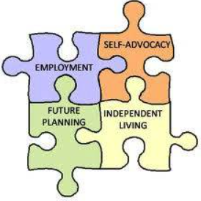
Transition Resources
The Life Career Assessment Matrix (LCAM)
Useful for IEPs, Transition Planning, VR Employment Planning, etc.
Transition Planning Time Line Checklist
National Association of Special Education Teachers (NASET)
Transition Resource Tables

Slide 10
Transition Serpentine Timeline
IEP Transition Services
16 Yrs. or earlier as appropriate:
Ensure availability of Work related documents
Invite Transition Related Agencies
Develop Post School Outcomes
Adult (18 Yrs. +)
Apply for SSI, IHSS (other generic resouces)
Register for Draft
Register to Vote
Apply to colleges
Explore post educational options
Pursue referrals from Regional Center
(6 months prior to exiting school)
Obtain a current physical exam
Update Immunizations
TB tests
CAREER PLAN
Mobility
Post
Educational Options/Supports
12-21 Yrs. & Update Annually:
Work on Self Determination & Self Advocacy Skills
Administer initial career/vocational assessment
Focus on improving adaptive & functional skills to increase independence
16-21 years:
Independent Travel
Training
Public or para transit
Needs for travel
attendant
Obtaining a Driver’s
License
Adult Day Center
Behavior Mgt. Programs
Tailored Day Services (TDS)
Work focused ADC
Supported Employment- Group
SEP-Individual
College Supports
Competitive Integrated Employment (CIE)
Independent/Supported Living Skills Training
Age of Majority
17+ Yrs:
Guardianship
Conservatorship
Circle of Support
Supported Decision Making
Investigate SSDI, SSI, Medicaid Programs
Work incentives
Review health insurance coverage
Develop Transition Component of IEP
16 Yrs. Or earlier as appropriate:
Explore community leisure activities
Consider employment/volunteer experience
Resume building
Tour supportive community agencies
Explore post educational opportunities

Slide 11
SGPRC Post Educational Options

Slide 12
SC Process: Gathering information- Obtaining input from the individual they support and their support system
What is important to John?
What type of job does John want to have?
Does he want to attend college?
What is important for John?
Family/support system input

Slide 13
Attending Individual Education Plan (IEP) Meetings to obtain input from teachers and other school specialists that provide direct services.
Review current services/supports in the IEP
What are John’s current educational goals?
What are John’s strengths?
What type of supports are in place to help John achieve his educational goals?
Is he on a Diploma Track or a Certificate of Completion Track?

Slide 14
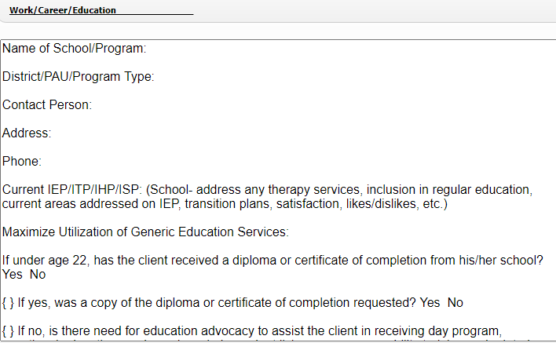
SCs add information to School Section of Individual Program Plan (IPP).

Slide 15
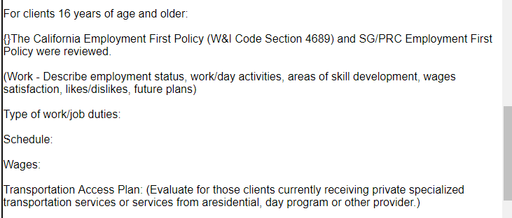

Slide 16
Post Educational Options
Supported Employment Individual
Supported Employment Group
Competitive Integrated Employment
Traditional Day Program (ADC) &
Behavior Management Programs
Work-focused Day Program (ADC)
Tailored Day Services

Slide 17
What to Consider when Selecting a Day Program vs. Vocational
Health
Safety
Behaviors
Self care needs
Medical conditions

Slide 18
PIP & CIE

Slide 19
Questions

