Slide 1
School of Continuing Education I.M.P.A.C.T.*
Susan Stroebel, M.S. Ed
Laura Espinoza-Rodriguez, DPA, MSW
Briseida Ramirez, MA
Yasmin Cardona-Byrne, MSW
I.M.P.A.C.T.*
Independent living skills, Mobility training, Physical health and well-being, Advocacy for self, College career and job readiness skills, and Technology training

Slide 2
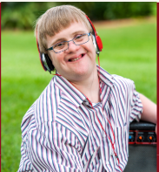
Agenda
Introductions
Why are we here?
What can we do to support our students?
How do we transition to online learning?
Open discussion

Slide 3
Introducing our Faculty
Share
Your name
Courses you teach
Attendees please share with us your
Name, title
Organization you are with

Slide 4
Why are we here?
Provide an informational presentation to discuss how to better assist our students transition into an online learning platform
To understand our students' needs and how their support systems can help in this transition
Share with you what steps we are taking to help with the transition

Slide 5
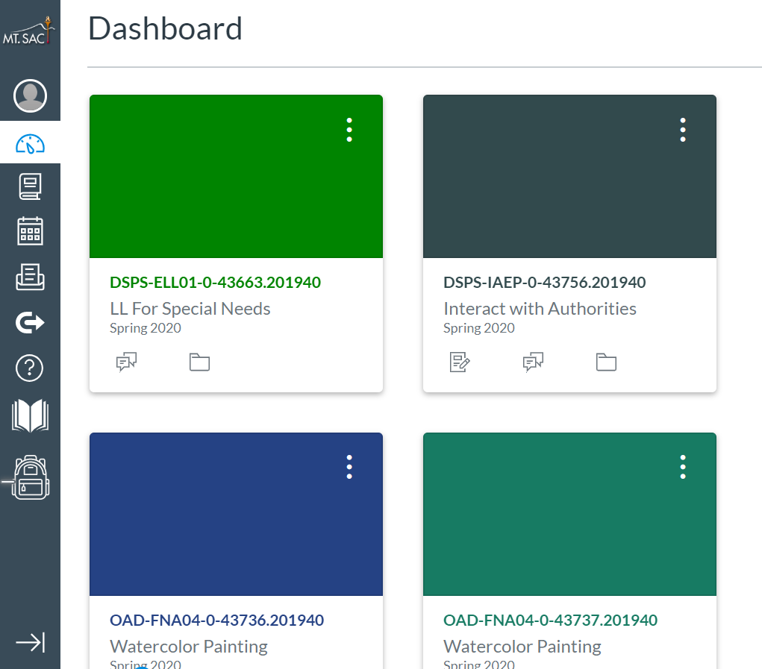
What are we doing to support our students?
Spring Term courses available through various temporary remote instruction (TRI) platforms
Asynchronous or Synchronous
Offer Variety of Courses:
Interacting with Authorities
Lifelong Learning:
Curriculum in Social Skills, Exercise, Math, English, Science, Money Management, Art, Cooking, Technology

Slide 6
Approved New Courses
Intro to Banking
Consumer Skills
Health and Fitness Skills
Money Skills
Basic Budgeting
Human Sexuality
Memory Building Skills

Slide 7
Ongoing Curriculum Development
Any suggestions?

Slide 8
What are we doing to support our students?
Registration
Open enrollment
Previously registered student
New student registration
Students 18+
NO COST to you
Support System
It is critical that students get the support they require to transition into Online learning
Canvas
Assess need for technology/ device

Slide 9
How do we transition to online learning?
Summer Courses
Canvas - Mt. SAC's Learning Management System (LMS)
Familiarize Support Systems to Canvas in order to assist our students transition to online learning
Collaborate with Support Systems
Only way we can make this happen for our students
IPP Goals

Slide 10
"If you have some respect for people as they are, you can be more effective in helping them to become better than they are"
J.W. Gardner

Slide 11
Open for Discussion
Questions
Comments
Feedback

Slide 12
For Any Further Questions...
Laura Espinoza Rodriguez, DPA, MSW
Lespinozarodriguez@mtsac.edu
Susan Stroebel, M.S. Ed
Sstroebel@mtsac.edu

